Slide 1
Nextflow and longgwas workshop
Alejandro Martinez-Carrasco
Notes:
10:15-10:35am EST - 20 minutes
Suggest - lead off my saying many analyses can be done and planned which Hampton will summarise - case-control and beyond
Here I will focus one aspect - the integration on clinical and genetic data to understand disease progression

Slide 2
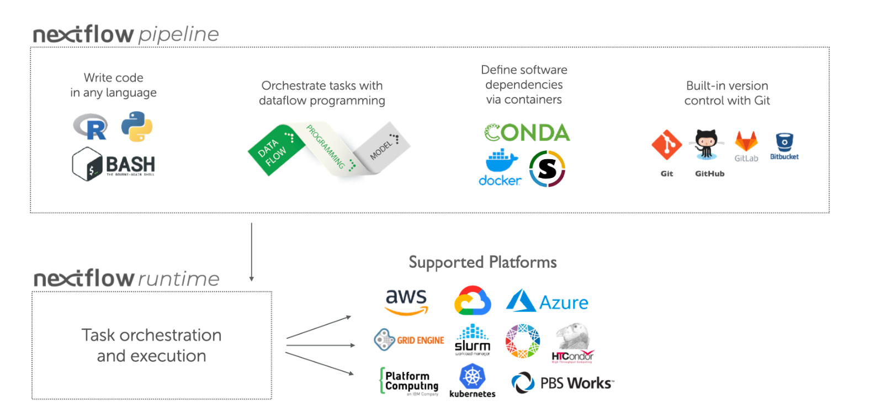
Processes, channels and operators
Nextflow is a workflow orchestration engine and a programming DSL that makes easy the writing of data-intensive computational pipelines
A workflow is constructed from a series of processes where outputs from one process is ingested by another process via channels
Nextflow’s core features are:
Workflow portability and reproducibility
Scalability of parallelization and deployment
Integration of existing tools, system
Notes:
In practice, a Nextflow workflow is made by joining together different processes. Each process can be written in any scripting language that can be executed by the Linux platform (Bash, Perl, Ruby, Python, etc.).
After commenting on the DSL thing… In practical terms, Nextflow scripting is an extension of the Groovy programming language which, in turn, is a super-set of the Java programming language. Groovy can be thought of as "Python for Java", in that it simplifies the writing of code and is more approachable.
Processes are executed independently and are isolated from each other, i.e., they do not share a common (writable) state. The only way they can communicate is via asynchronous first-in, first-out (FIFO) queues, called channels.
Any process can define one or more channels as an input and output. The interaction between these processes, and ultimately the workflow execution flow itself, is implicitly defined by these input and output declarations.

Slide 3
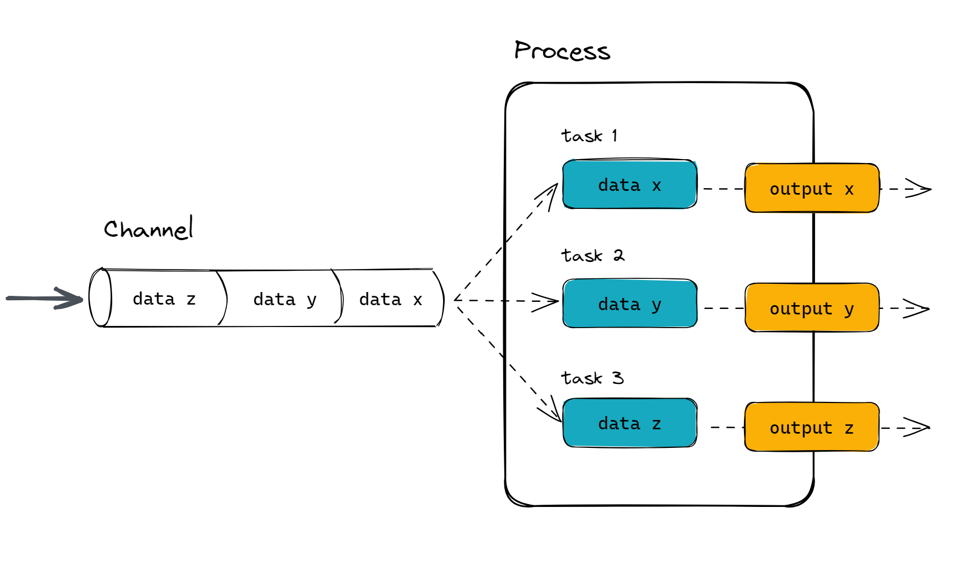
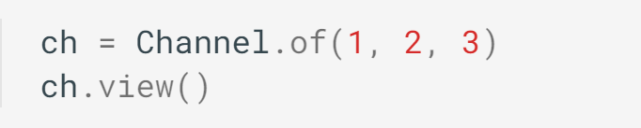
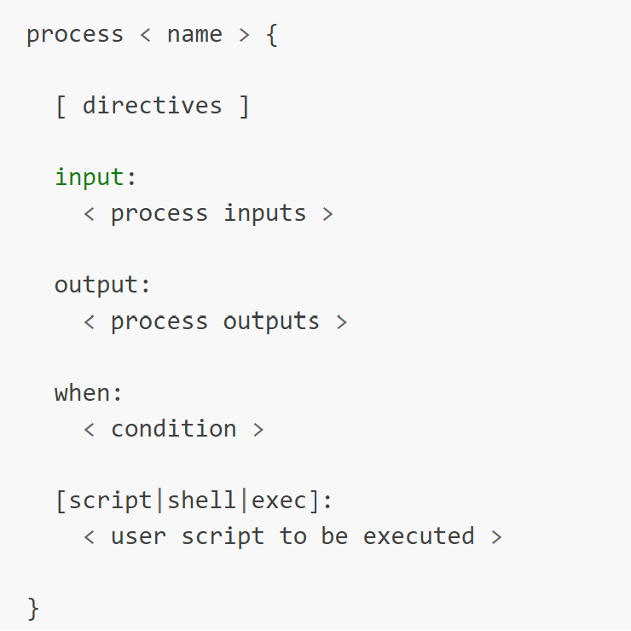
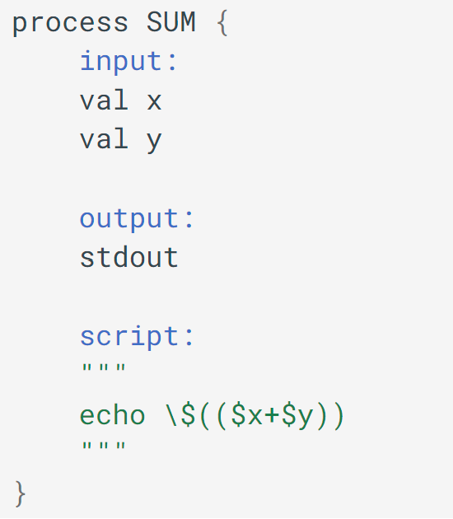
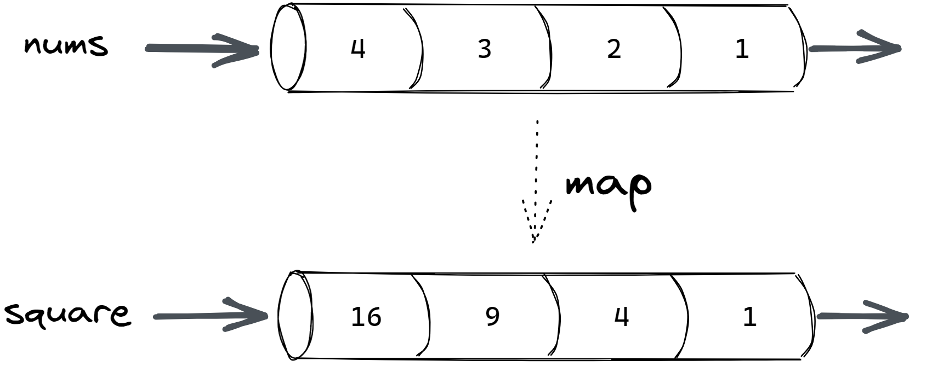
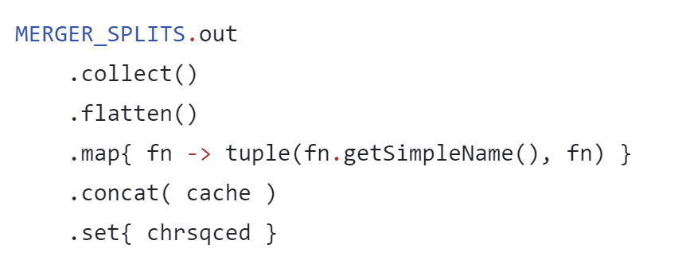
Processes, channels and operators
Channels
They connect tasks to each other or to implement functional style data transformations. Two main types:
Queue channels
Value channels
Processes
Basic computing primitive
to execute foreign functions
Operators
Methods to connect channels,
transform values, or apply some rules
Notes:
n practice, a Nextflow workflow is made by joining together different processes. Each process can be written in any scripting language that can be executed by the Linux platform (Bash, Perl, Ruby, Python, etc.).
Processes are executed independently and are isolated from each other, i.e., they do not share a common (writable) state. The only way they can communicate is via asynchronous first-in, first-out (FIFO) queues, called channels.
Any process can define one or more channels as an input and output. The interaction between these processes, and ultimately the workflow execution flow itself, is implicitly defined by these input and output declarations.
In Nextflow, a process is the basic computing primitive to execute foreign functions (i.e., custom scripts or tools).
The process definition starts with the keyword process, followed by the process name and finally the process body delimited by curly brackets.
The process name is commonly written in upper case by convention.
A basic process, only using the script definition block, looks like the following:

Slide 4
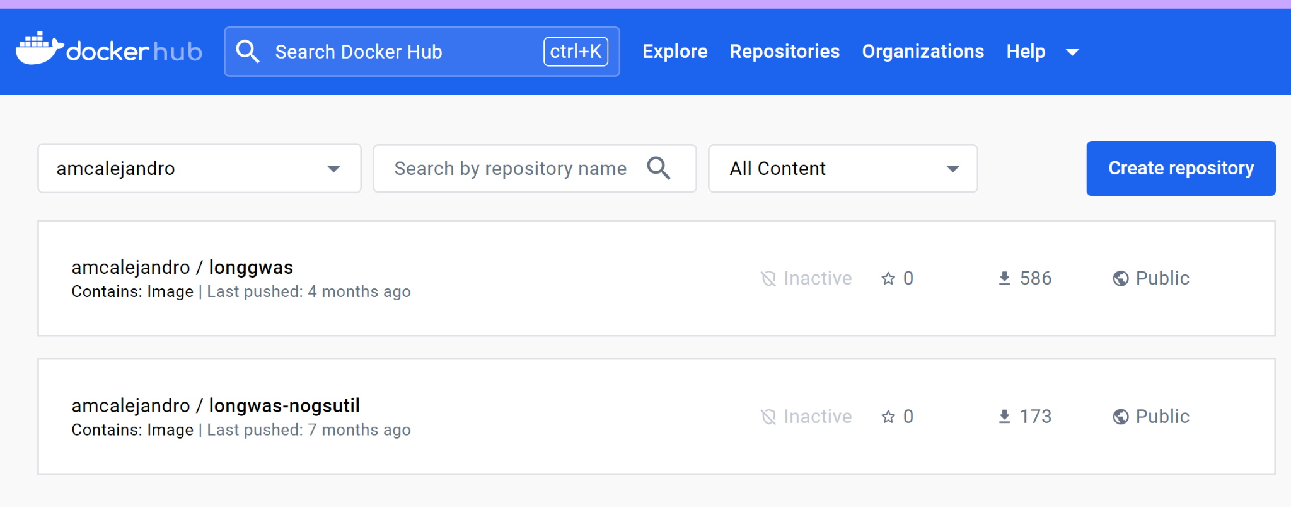
Manage dependencies and containers
Computational workflow are often composed of multiple scripts or tools each of these depends on multiple software components or libraries
Containers are a great solution to maintain workflow dependencies and ease reproducibility.
Docker container allow us to create immutable Linux container images that can be deployed in any platform that supports container runtime
Docker is a handy management tool to build, run and share container images
Notes:
Computational workflows are rarely composed of a single script or tool. More often, they depend on dozens of software components or libraries.
Installing and maintaining such dependencies is a challenging task and the most common source of irreproducibility in scientific applications.
To overcome these issues, we use containers that enable software dependencies, i.e. tools and libraries required by a data analysis application, to be encapsulated in one or more self-contained, ready-to-run, immutable Linux container images, that can be easily deployed in any platform that supports the container runtime.
Containers can be executed in an isolated manner from the hosting system. Having its own copy of the file system, processing space, memory management, etc.
Docker is a handy management tool to build, run and share container images.
These images can be uploaded and published in a centralized repository known as Docker Hub, or hosted by other parties like Quay.
Docker is an open platform for developing, shipping, and running applications. Docker enables you to separate your applications from your infrastructure so you can deliver software quickly. With Docker, you can manage your infrastructure in the same ways you manage your applications. By taking advantage of Docker's methodologies for shipping, testing, and deploying code, you can significantly reduce the delay between writing code and running it in production.
Docker provides the ability to package and run an application in a loosely isolated environment called a container. The isolation and security lets you to run many containers simultaneously on a given host. Containers are lightweight and contain everything needed to run the application, so you don't need to rely on what's installed on the host. You can share containers while you work, and be sure that everyone you share with gets the same container that works in the same way.
Docker provides tooling and a platform to manage the lifecycle of your containers:
Develop your application and its supporting components using containers.
The container becomes the unit for distributing and testing your application.
When you're ready, deploy your application into your production environment, as a container or an orchestrated service. This works the same whether your production environment is a local data center, a cloud provider, or a hybrid of the two.

Slide 5
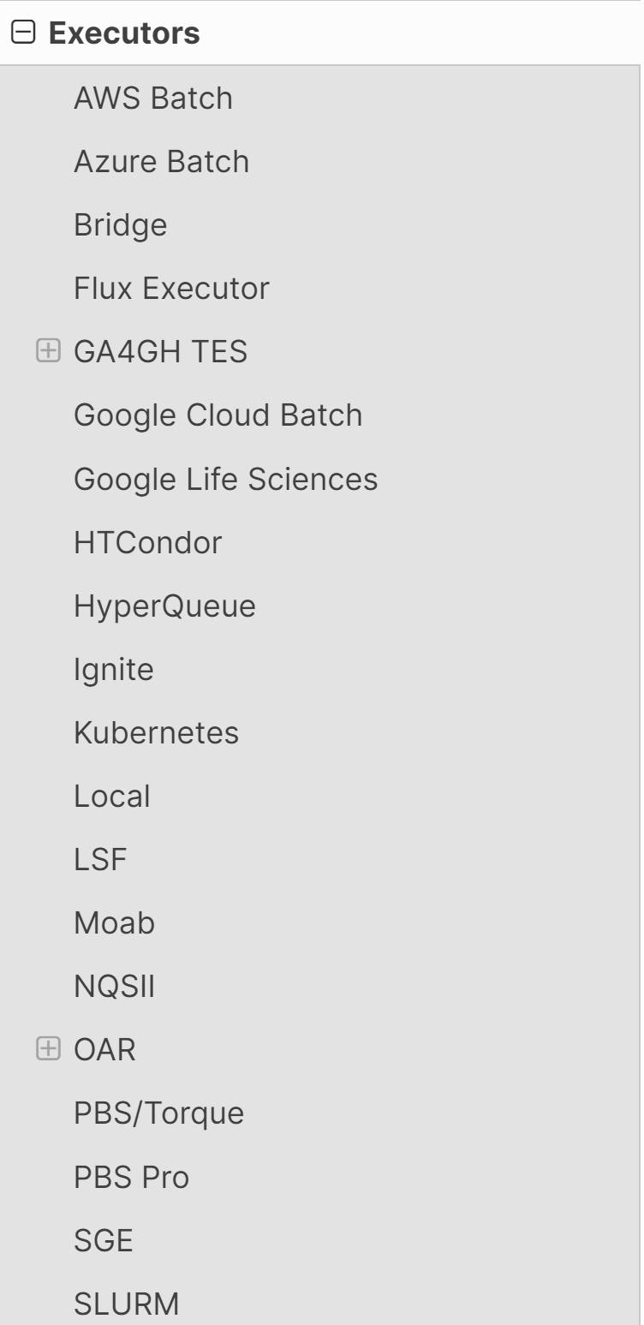
Executors
While a process defines what command or script has to be executed, the executor determines how that script is run in the target platform
Executors are often high-performance computing (HPCs) or cloud platforms. Executors can be local as well ( development and testing purposes mostly)
Notes:
While a process defines what command or script has to be executed, the executor determines how that script is run in the target platform.
If not otherwise specified, processes are executed on the local computer. The local executor is very useful for workflow development and testing purposes, however, for real-world computational workflows a high-performance computing (HPC) or cloud platform is often required.
In other words, Nextflow provides an abstraction between the workflow’s functional logic and the underlying execution system (or runtime). Thus, it is possible to write a workflow that runs seamlessly on your computer, a cluster, or the cloud, without being modified. You simply define the target execution platform in the configuration file.
Nextflow implements a declarative DSL that simplifies the writing of complex data analysis workflows as an extension of a general-purpose programming language.
This approach makes Nextflow flexible — it provides the benefits of a concise DSL for the handling of recurrent use cases with ease and the flexibility and power of a general-purpose programming language to handle corner cases in the same computing environment. This would be difficult to implement using a purely declarative approach.
In practical terms, Nextflow scripting is an extension of the Groovy programming language which, in turn, is a super-set of the Java programming language. Groovy can be thought of as "Python for Java", in that it simplifies the writing of code and is more approachable.

Slide 6
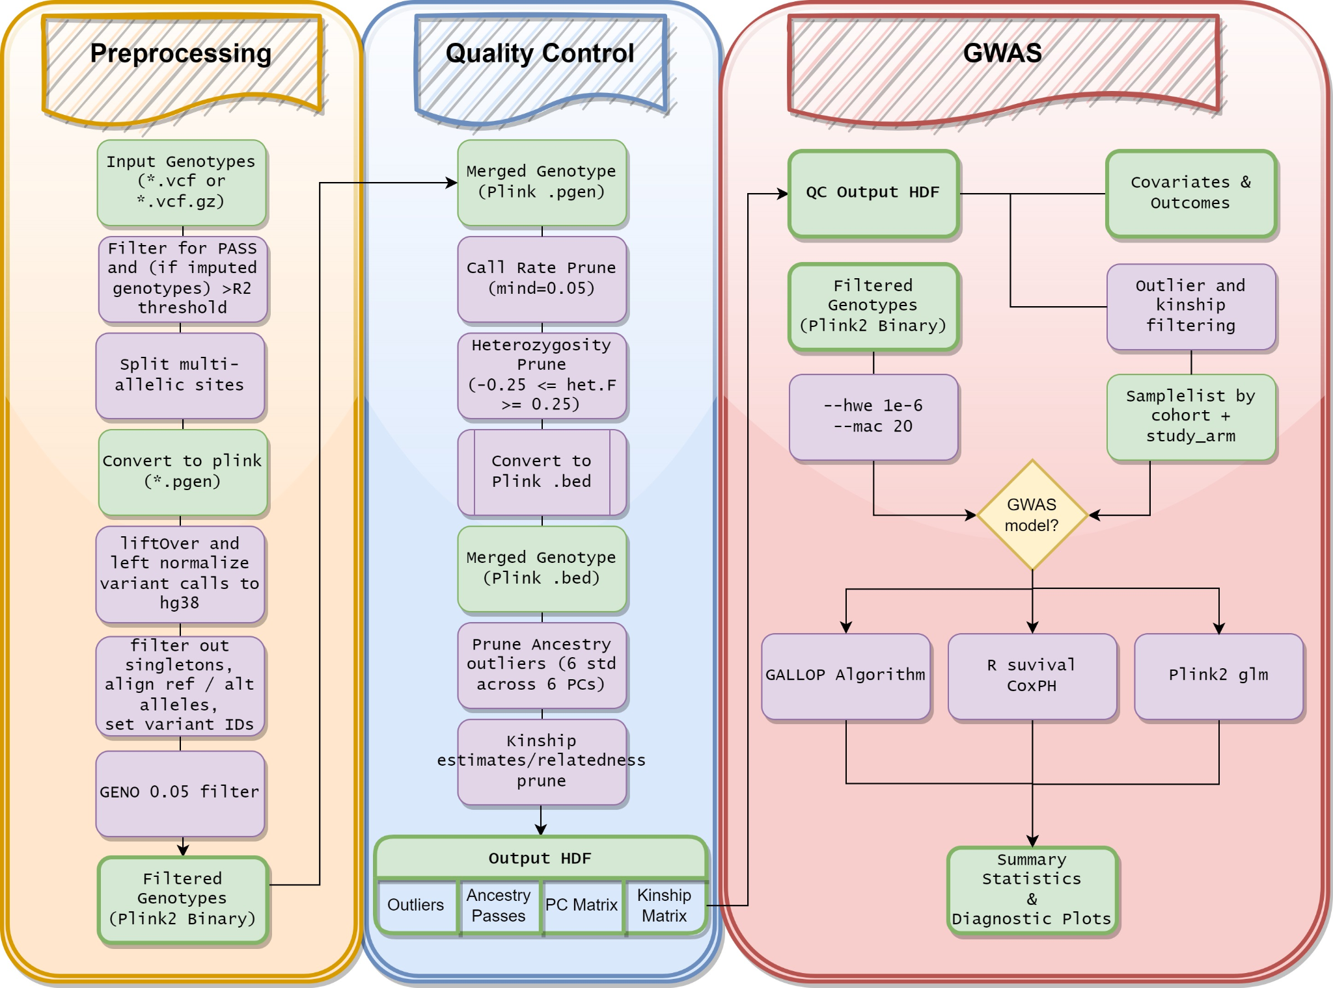
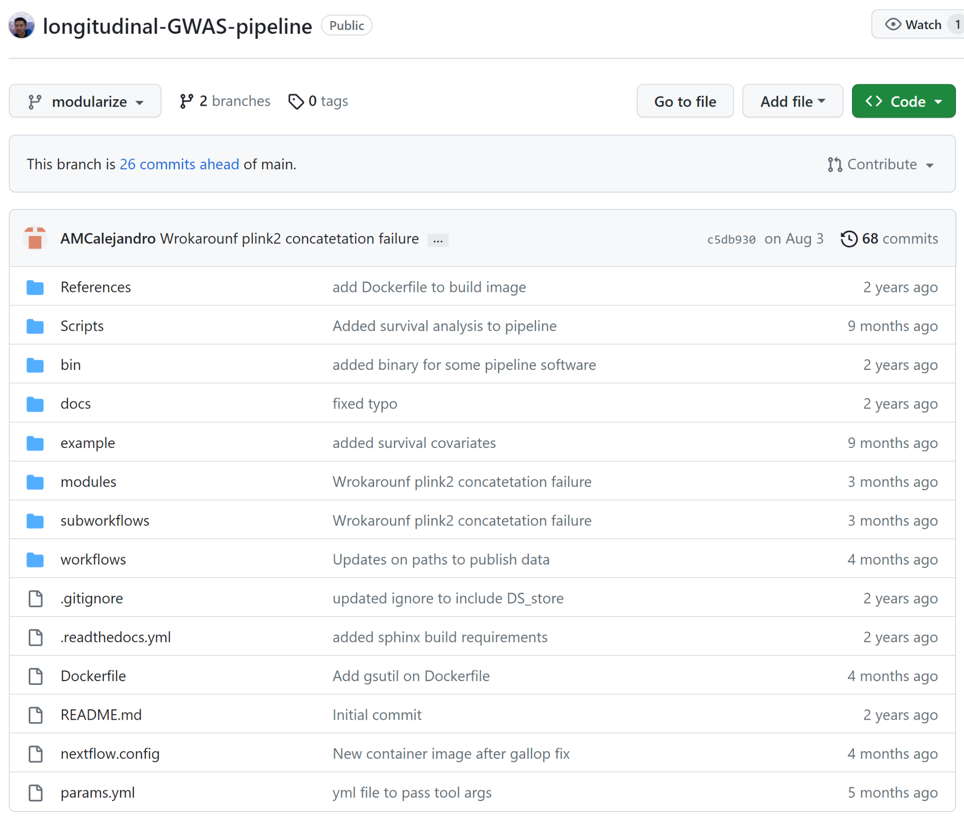
What is longgwas
Documentation

Slide 7
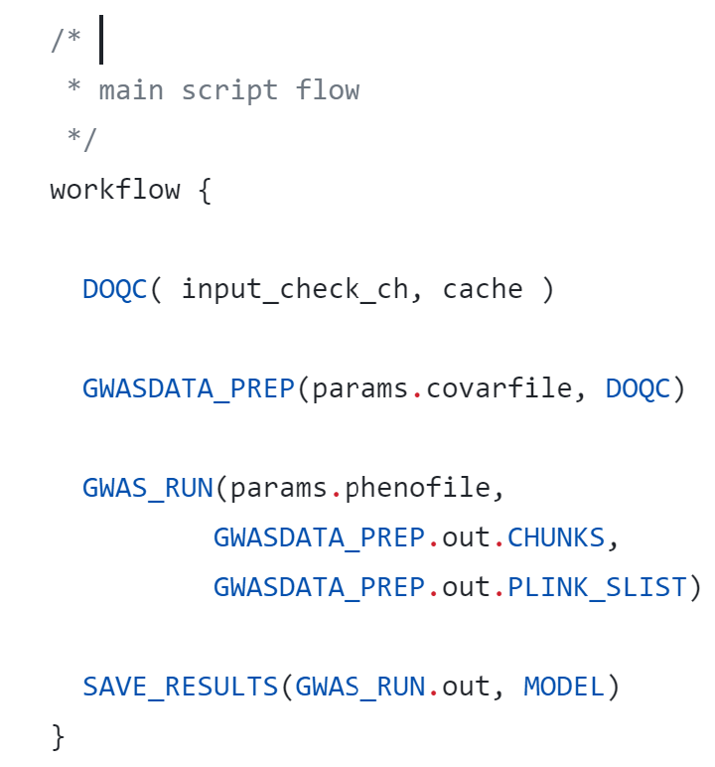
Longgwas components
Configuration file (.config)
A way to specify a set of priorities. Configuration files allow you to specify what the different executors are and the priorities for each executor
YAML (.yml)
A set of arguments values that can passed together with the main workflow
Nextflow scripts (.nf)
Nextflow script file format. nf format files are used to create processes, modules and workflows

Slide 8
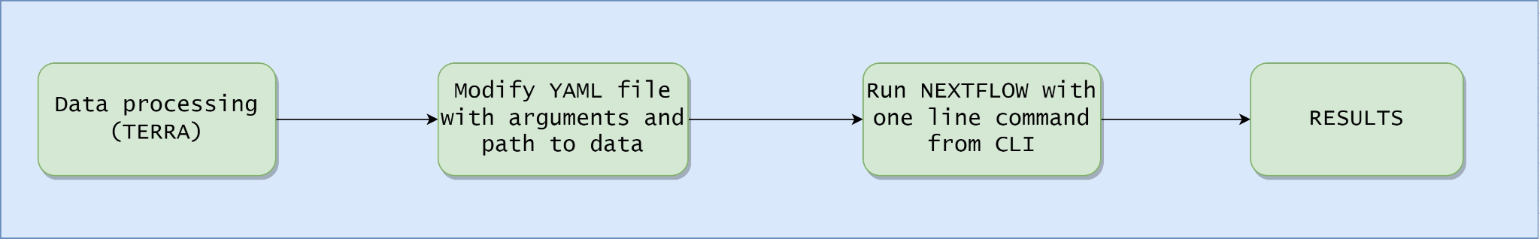
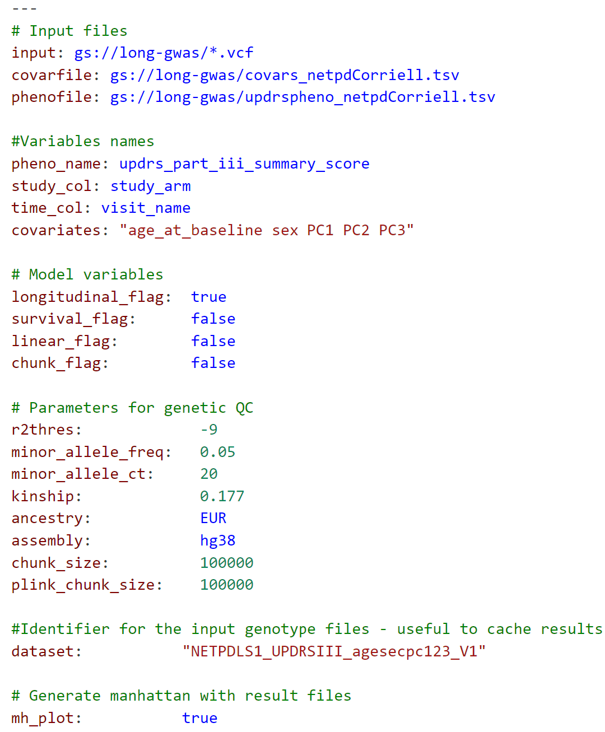
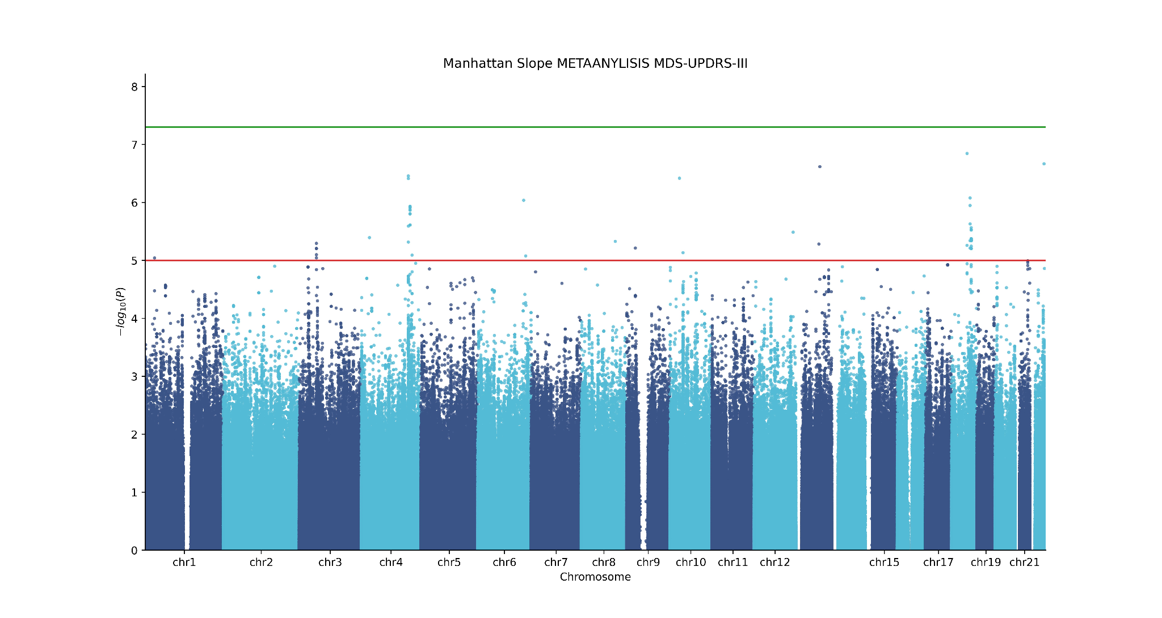
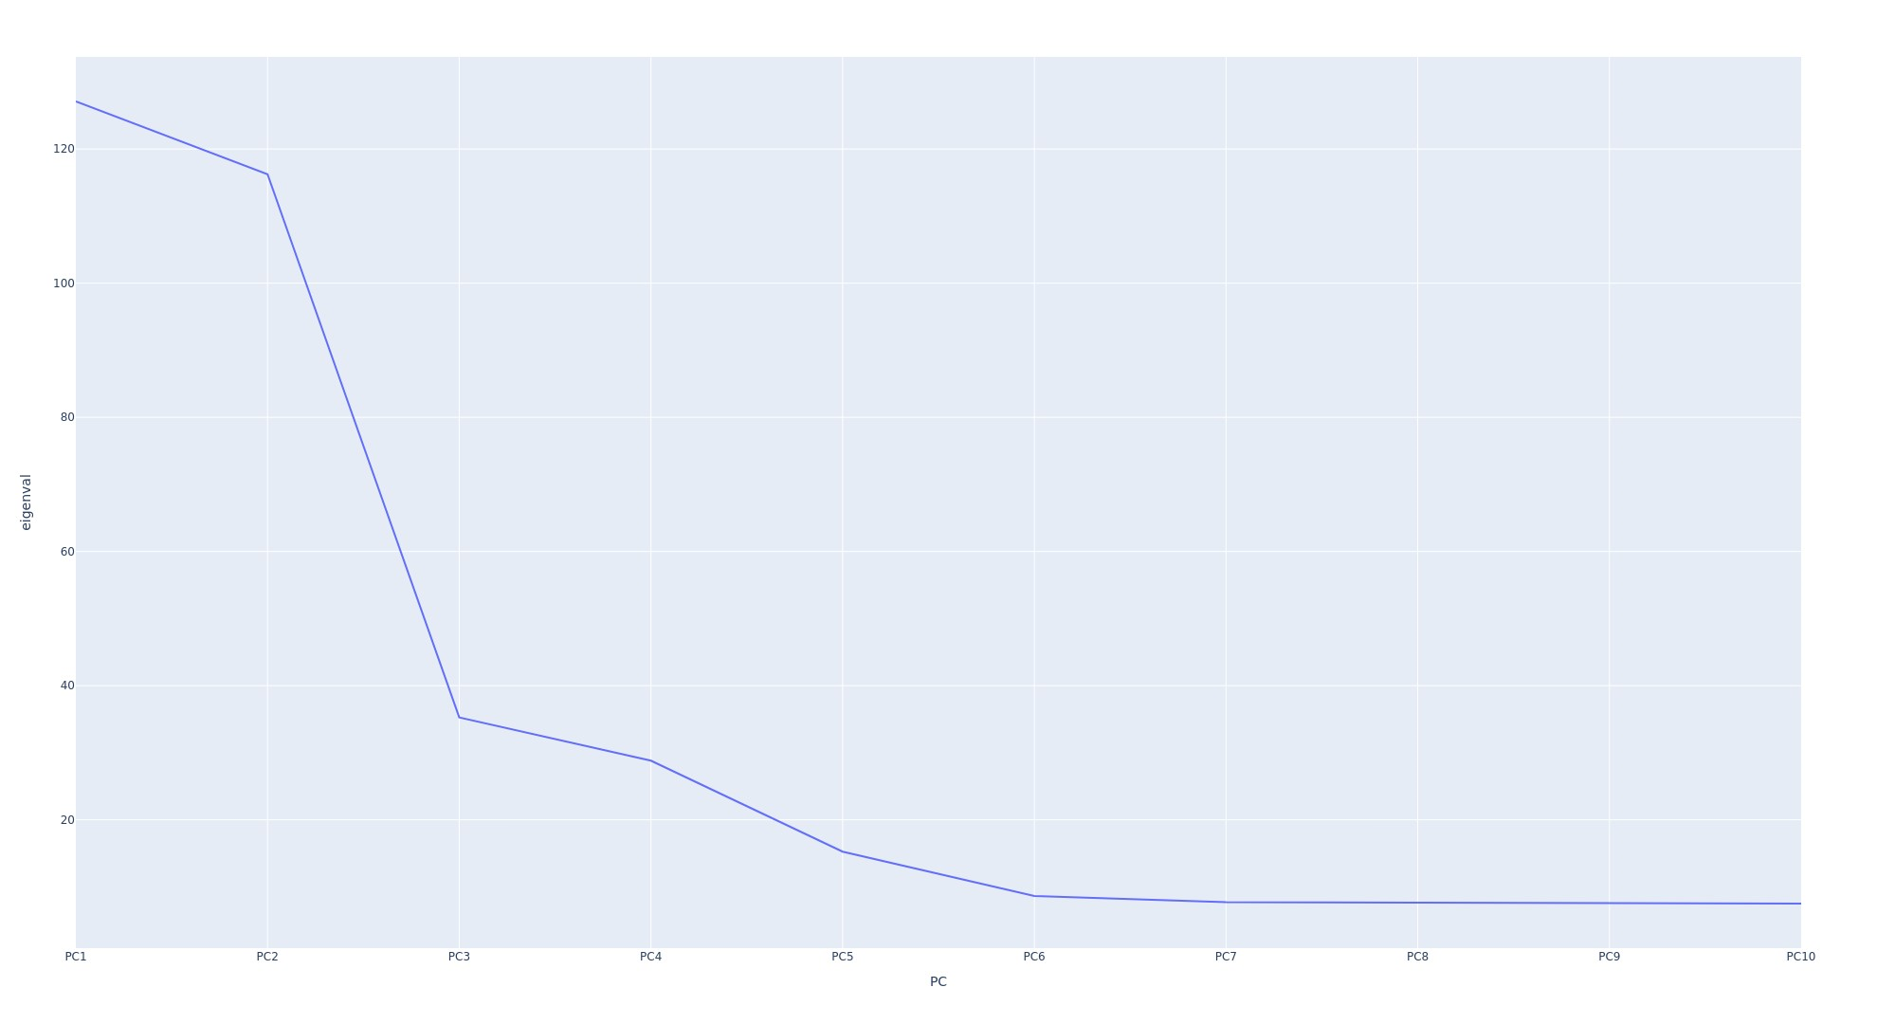
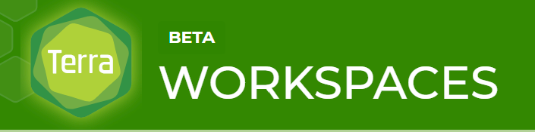
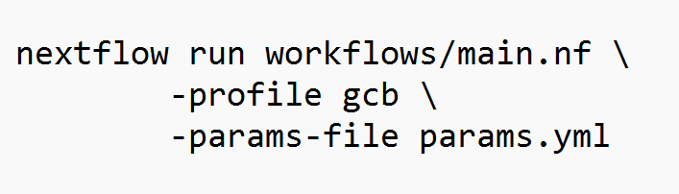
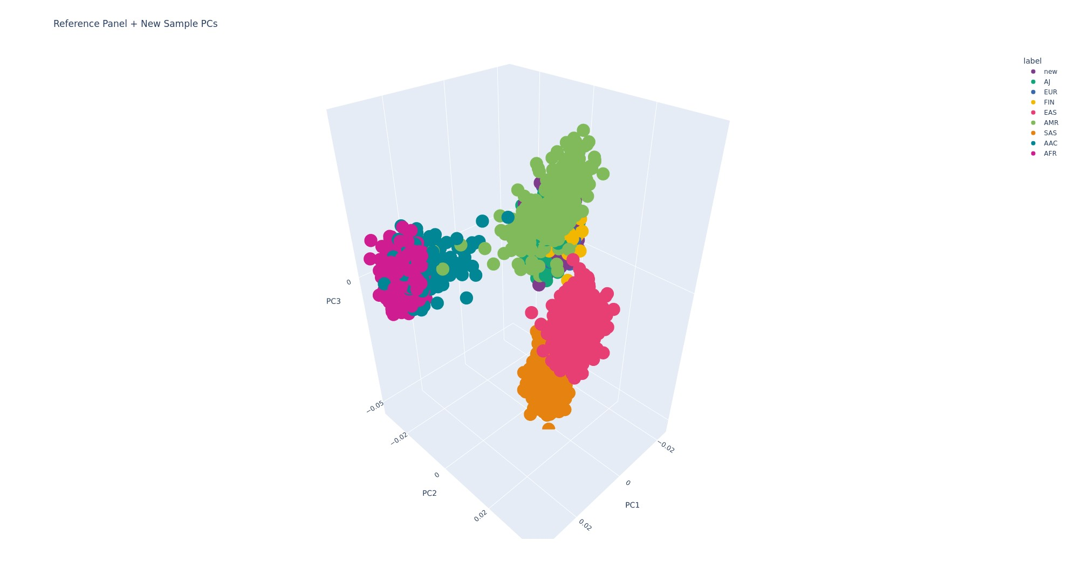
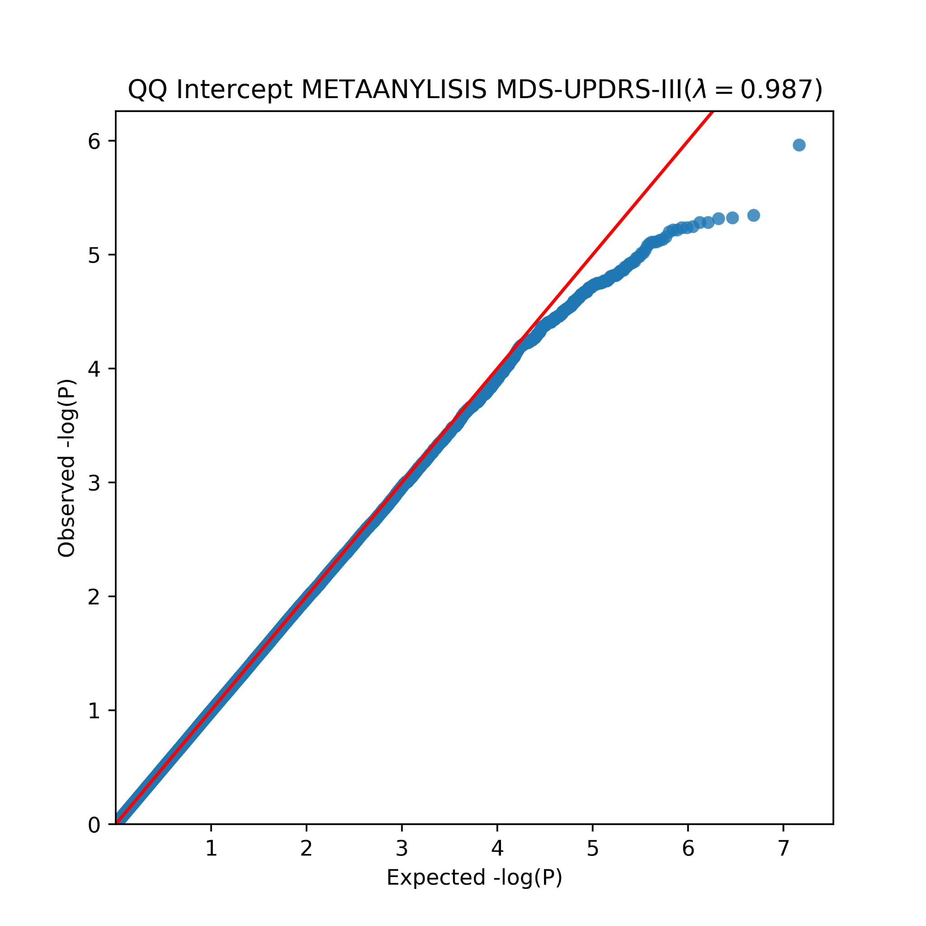
Workflow

Slide 9
More features coming
Functional annotation is currently being added to nextflow longgwas tool
Fine-mapping and SMR (summary level mendelian randomization might be added as well)

